Slide 1

CYBERSECURITY NETWORK INTRUSION DETECTION
PATTERN VISUALIZATION DASHBOARD
A simple dashboard that turns raw network data into easy-to-read charts, so security teams can quickly spot attacks
Guided by
Presented by
Dr. S. Senthilvadivu
Surya JK (192324285)
Akash S (192324298)
Jaana Nithish (192324275)

Slide 2


Introduction
Every network keeps a record (a "log") of all the traffic passing through it. Hidden inside these huge logs are a few malicious connections — but they are hard to spot.
Attacks come in different forms: some flood the network, some try to sneak in, and some try to steal higher access. Each type behaves a little differently.
The NSL-KDD dataset used here has thousands of network connections with many columns of data — too much for a person to read row by row.
This project builds a dashboard that turns that raw data into simple charts, so anyone can quickly see what is normal traffic and what looks suspicious.

Slide 3
Literature Survey
Key research foundations supporting the proposed dashboard
Study / Resource
Contribution
Gap / Relevance
Tavallaee et al. (2009) – NSL-KDD
Improved benchmark derived from KDD’99 for intrusion-detection research.
Provides the project’s standardized network-traffic dataset.
Lakhina et al. (2004) – Network traffic anomaly detection
Explored traffic distributions and anomaly detection using network measurements.
Motivates distribution and relationship visualization.
Breiman (1996) – Bagging
Introduced bootstrap aggregation and demonstrated bootstrap-based sampling ideas.
Supports resampling concepts used for uncertainty estimation.
Efron & Tibshirani (1993) – Bootstrap
Established bootstrap methods for estimating sampling distributions and confidence intervals.
Basis for uncertainty-bounded anomaly-rate estimates.
Pedregosa et al. (2011) – Scikit-learn
Presented a widely used Python machine-learning toolkit.
Supports preprocessing, scaling, encoding, and feature workflows.

Slide 4
Problem Statement
Network logs are huge, and real attacks are rare — like finding a few odd items in a massive pile, which makes them easy to miss.
Important details like packet count or connection time are rarely looked at as pictures/graphs, so unusual values go unnoticed.
It is hard to tell at a glance which attack type (DoS, Probe, R2L, U2R) is the biggest problem right now.
When we say "X% of traffic looks abnormal," there is no way to know how sure or unsure that number really is.
We rarely compare two traffic features together, so patterns that only show up when features are combined get missed.

Slide 5
Objectives
Clean and prepare the NSL-KDD network data so it is ready to analyse (using Pandas and Scikit-learn).
Show how each traffic feature is spread out, using histograms and ECDF graphs.
Show which attack types are most common, using pie charts and stacked bar charts.
Show how two traffic features relate to each other, using hexbin plots and scatterplots.
Calculate the anomaly rate along with a confidence range, so we know how trustworthy the number is.
Bring all of this together into one easy-to-read dashboard for security teams.

Slide 6
Module 1: Network Traffic Log Preprocessing & Feature Module
Cleaning the raw data and preparing it for analysis
Loads the raw NSL-KDD traffic log and fixes problems in it — missing values, text fields like protocol type, and numbers on very different scales.
Uses Pandas to clean the data and Scikit-learn to convert it into a format that is ready for analysis.
Draws histograms and ECDF graphs to show how each feature (like duration or packet count) is spread out, and to spot unusual values.
Main columns used: source/destination IP, protocol, attack type, packet count, connection duration, and anomaly score.

Slide 7
Module 2: Intrusion Type Distribution & Proportion Module
Showing which attack types occur the most
Counts how many connections belong to each attack type — DoS, Probe, R2L, U2R — compared to normal traffic.
A pie chart shows this split at a glance, so anyone can see the biggest threat category immediately.
A stacked bar chart shows the same split, but broken down by protocol, so analysts can see which service is most attacked.
Seaborn is used to make these charts clear and easy to read.

Slide 8
Module 3: Traffic Relationship & Anomaly Uncertainty Module
Comparing features together and measuring how reliable the results are
Compares two traffic features at once (for example, connection duration vs. bytes transferred) using hexbin and scatter plots.
This makes it easy to see where attack traffic clearly separates from normal traffic.
Uses a technique called bootstrapping — repeatedly resampling the data — to estimate the anomaly rate many times.
From this, a confidence interval is calculated, so we know not just the anomaly rate but also how much to trust it.

Slide 9
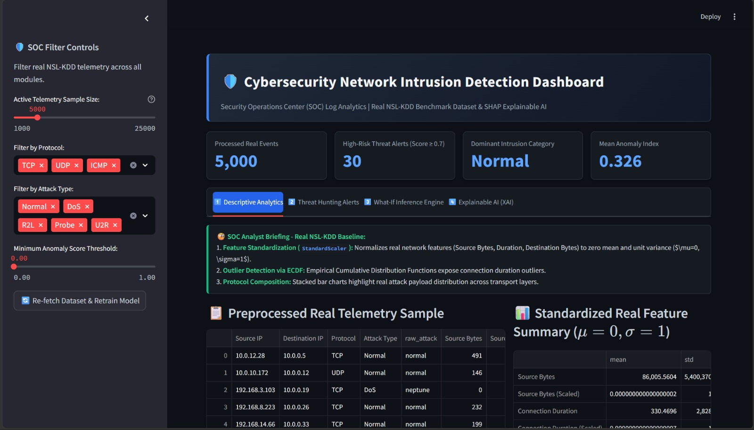
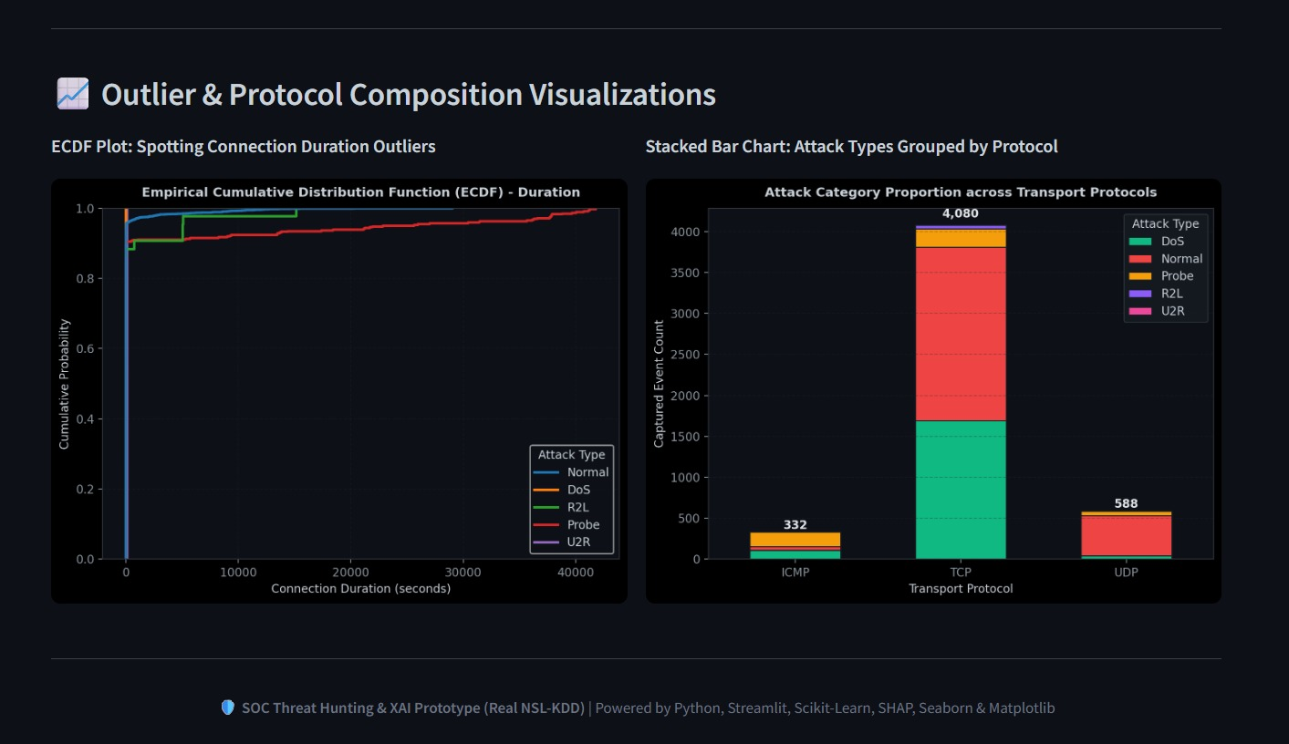
IMPLEMENTATION

Slide 10
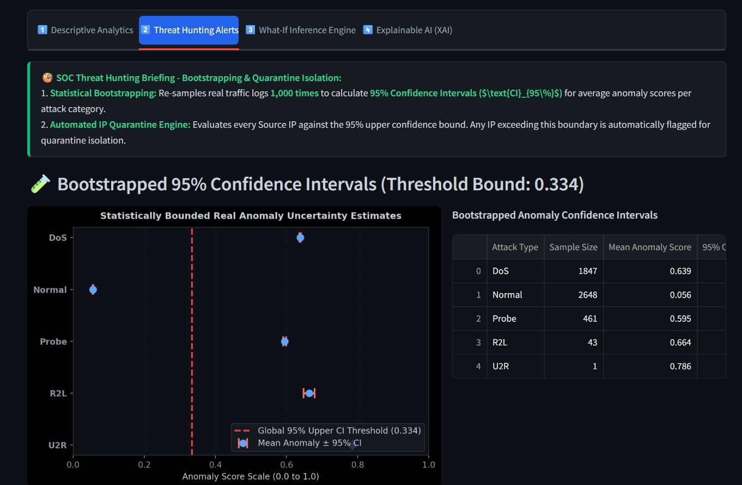
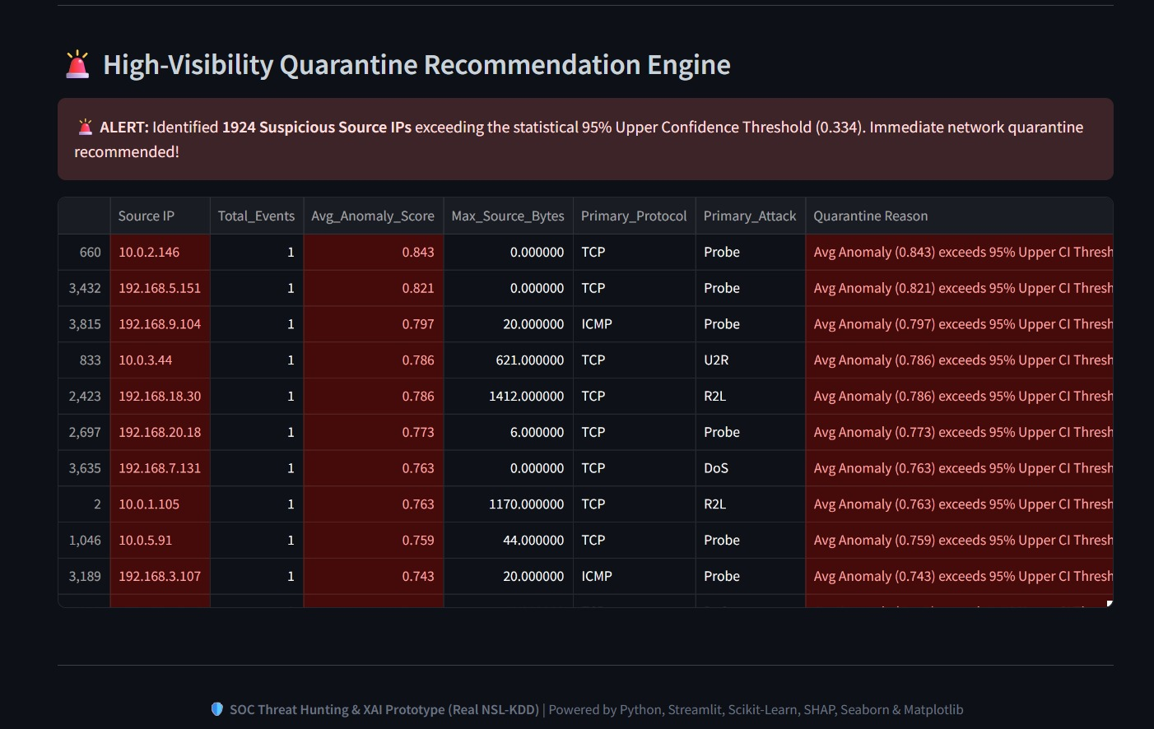
IMPLEMENTATION

Slide 11
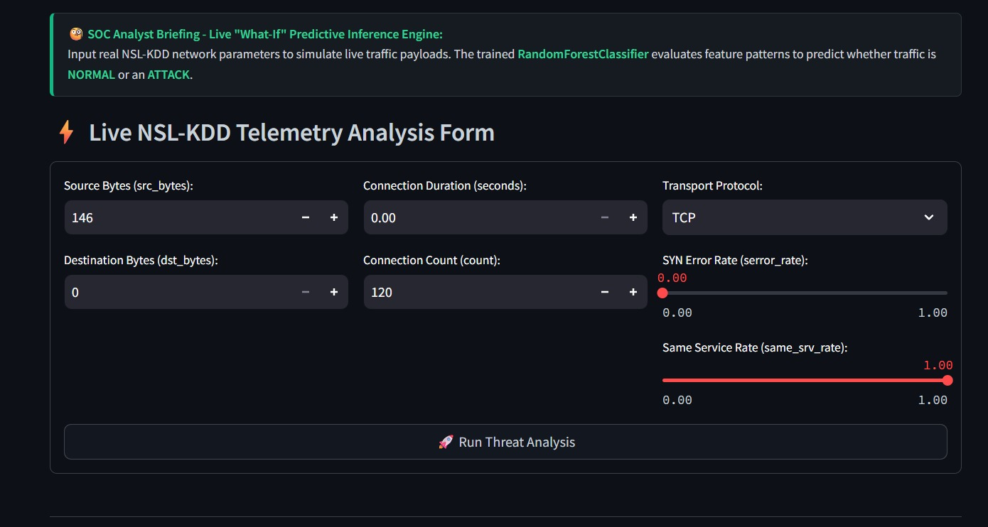
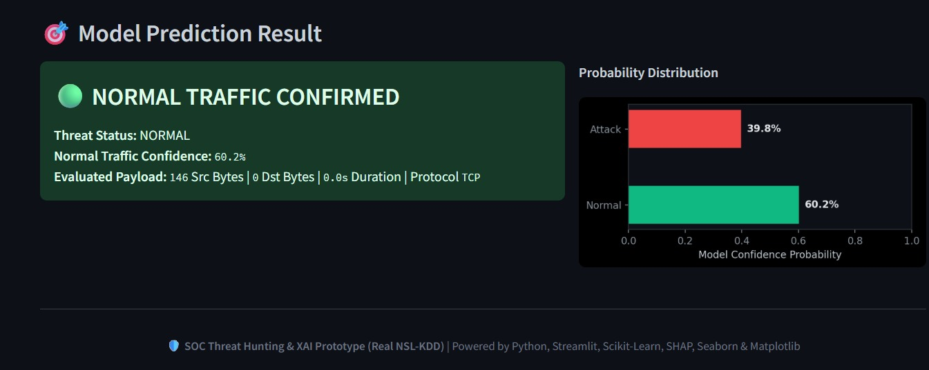
IMPLEMENTATION

Slide 12
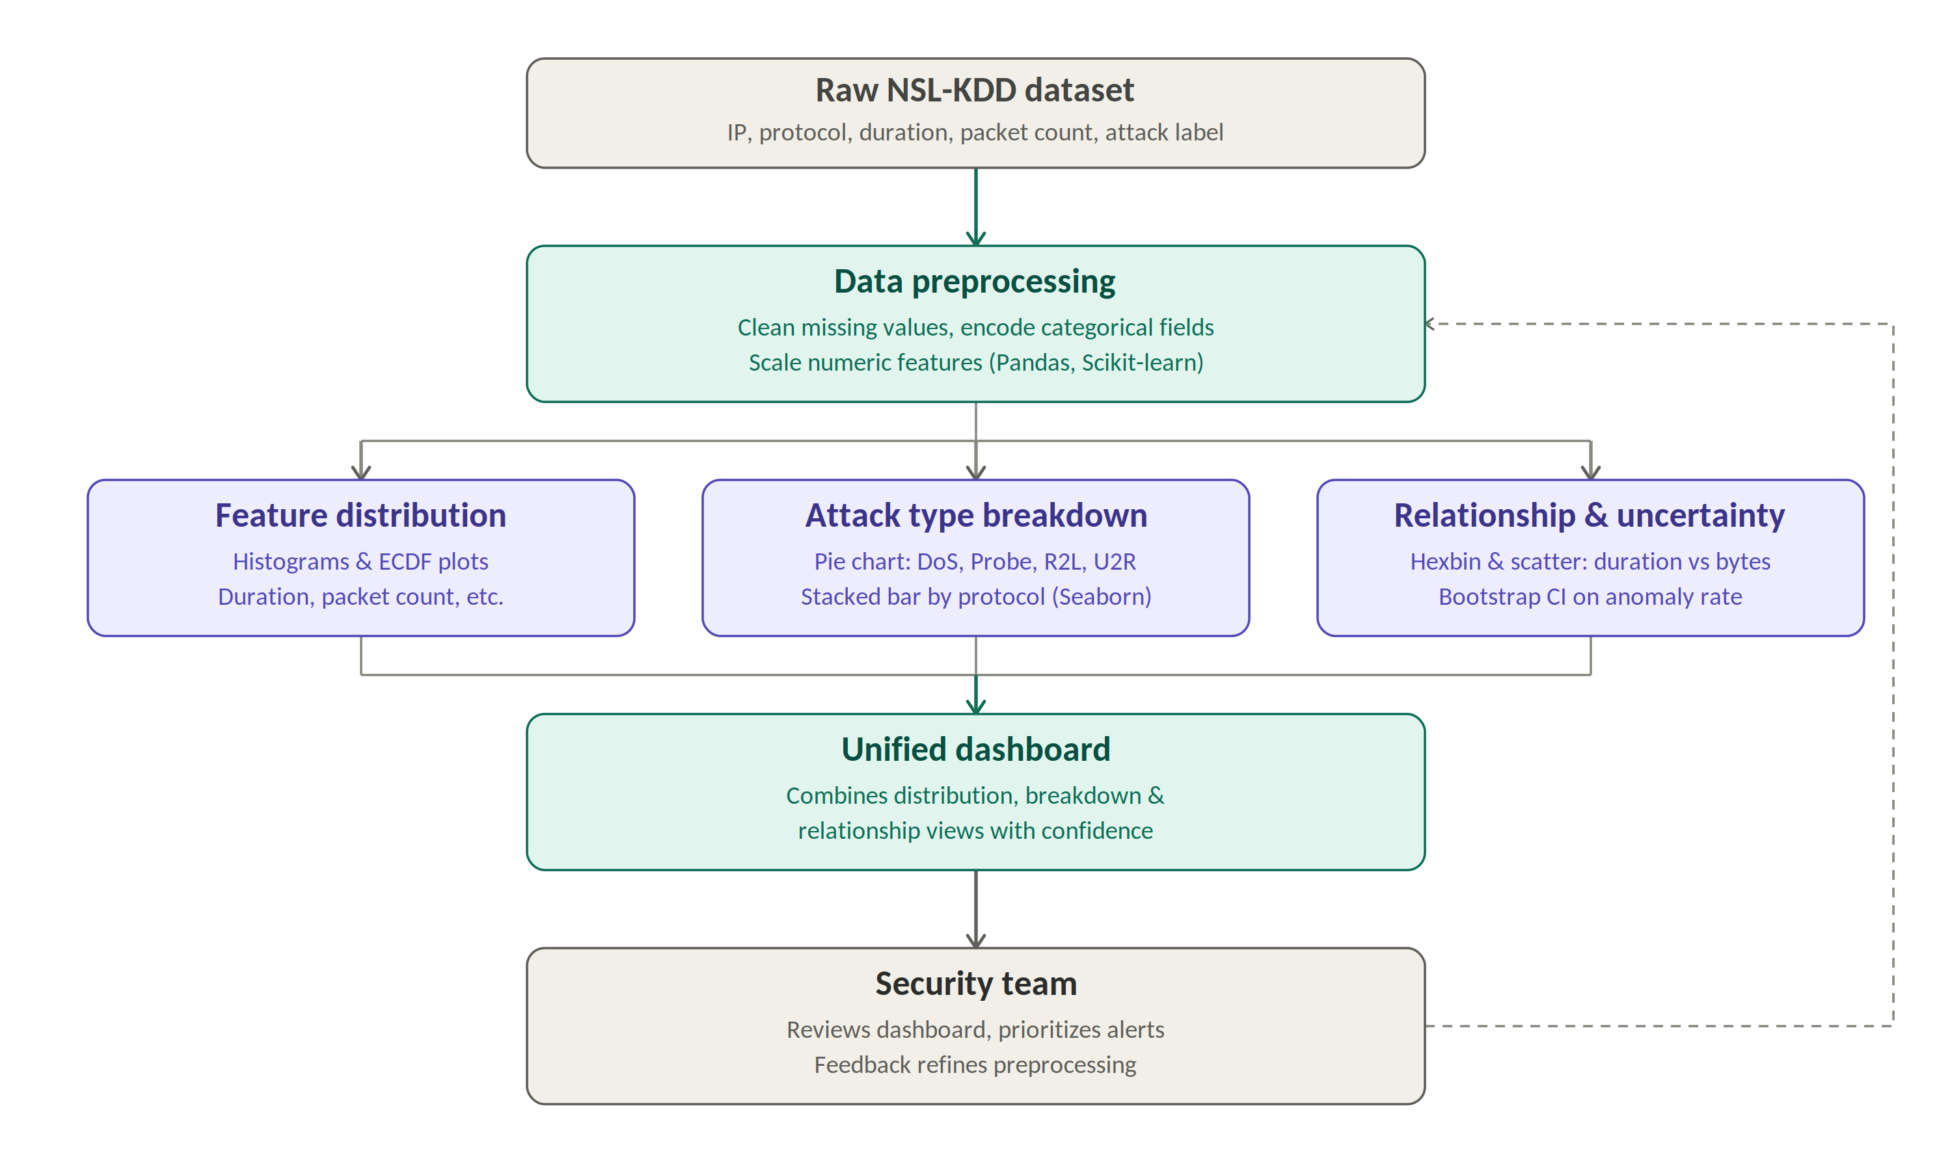
How the Dashboard Works (Architecture)
The security team looks at the dashboard to decide what to check first, and their feedback helps improve the data preparation step over time.

Slide 13
Future Scope
Connect the dashboard to live network traffic instead of a fixed dataset, so it can monitor in real time.
Add machine learning models to help catch anomalies that simple statistics might miss.
Automatically rank alerts by how serious and how certain they are, so the most urgent ones show up first.
Test the system on other datasets and real company network data, not just NSL-KDD.
Add a feature that explains *why* a connection was flagged, not just that it was flagged.
Turn the dashboard into a website that security teams can log into and use directly.

Slide 14
Conclusion
This project takes raw, messy network data and turns it into a simple, three-step dashboard: clean the data, show attack patterns, and compare features with confidence levels.
It makes it easy for anyone — not just experts — to see which attacks are common and which traffic looks suspicious.
Instead of just saying "X% looks abnormal," the dashboard also shows how confident we can be in that number.
The project shows practical, hands-on use of Pandas, Scikit-learn, and Seaborn to solve a real security problem.
Next steps include real-time monitoring, smarter detection with machine learning, and making it available as a web tool.

Slide 15
References
Tavallaee, M., Bagheri, E., Lu, W., & Ghorbani, A. A. (2009). A Detailed Analysis of the KDD CUP 99 Data Set. IEEE CISDA.
NSL-KDD Dataset — Canadian Institute for Cybersecurity, University of New Brunswick.
Pedregosa, F., et al. (2011). Scikit-learn: Machine Learning in Python. JMLR, 12, 2825-2830.
McKinney, W. (2010). Data Structures for Statistical Computing in Python (pandas). Proc. 9th Python in Science Conf.
Waskom, M. L. (2021). seaborn: statistical data visualization. Journal of Open Source Software, 6(60), 3021.
Efron, B., & Tibshirani, R. J. (1994). An Introduction to the Bootstrap. Chapman & Hall/CRC.
Course Reference Units III-V: Distribution Plots, Relationship Plots, and Bootstrapping & Confidence Intervals.

Slide 16
Thank
you!

